Slide 1
Bike Sharing Demand Prediction
Raghvendra Singh
With
Team Member

Slide 2
Agenda
PROBLEM DESCRIPTION
BUSINESS UNDERSTANDING
EXPLORATORY DATA ANALYSIS
MODEL BUILDING
CONCLUSION

Slide 3
PROBLEM DESCRIPTION
Currently Rental bikes are introduced in many urban cities for the enhancement of mobility comfort. It is important to make the rental bike available and accessible to the public at the right time as it lessens the waiting time. Eventually, providing the city with a stable supply of rental bikes becomes a major concern. The crucial part is the prediction of bike count required at each hour for the stable supply of rental bikes.

Slide 4
BUSINESS UNDERSTANDING
Bike rentals have become a popular service in recent years and it seems people are using it more often. With relatively cheaper rates and ease of pick up and drop at own convenience is what making this business thrive.
Mostly used by people having no personal vehicles and also to avoid congested public transport that’s why they prefer rental bike.
Therefore the business to strive and profit more, it has to be always ready and supply no. of bikes at different locations, to fulfill the demand.
Our project goal is a pre planned set of bike count values that can be a handy solution to meet all demands.

Slide 5
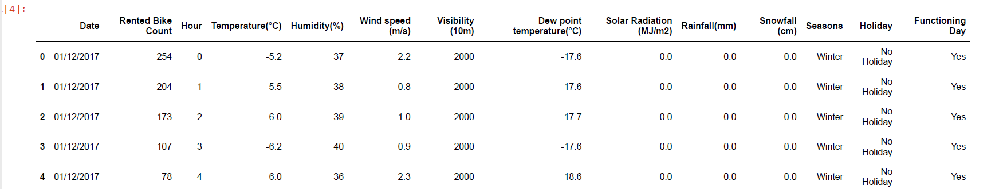
DATA SUMMARY
This dataset contain 8760 rows and 14 columns
Three categorical feature ‘Seasons’, ‘Holiday’ & ‘Functioning Day’
One datetime column ‘Date’
We have some numerical type variable such ad temperature, humidity, wind, visibility, dew point temp, solar radiation, rainfall, snowfall which shows the environmental conditions for that particular hour of the day.

Slide 6
DATA SUMMARY
There are no missing values present.
There are no Duplicate values present.
There are no null values.
The dependent variable is ‘rented bike count’ which we need to make predictions on.
The dataset shows hourly rental data for one year(1 December 2017 to 31 November 2018)(365 days).
We changed the feature ‘Date’ to Day, Month and Year.

Slide 7
FEATURE TYPES
FEATURES
TARGET VARIABLE
NUMERICAL
Hour
Temp
Humidity
Wind
Rainfall
Snow
Visibility
Solar Radiation
Day
Month
Year
CATEGORICAL
Seasons
Holiday
Functioning day
Rented Bike Count

Slide 8
FEATURE SUMMARY
Date : year-month-day
Rented Bike count - Count of bikes rented at each hour
Hour - Hour of he day
Temperature-Temperature in Celsius
Humidity - %
Windspeed - m/s
Visibility - 10m
Dew point temperature - Celsius
Solar radiation - MJ/m2
Rainfall - mm
Snowfall - cm
Seasons - Winter, Spring, Summer, Autumn
Holiday - Holiday/No holiday
Functional Day - NoFunc(Non Functional Hours), Fun(Functional hours)

Slide 9
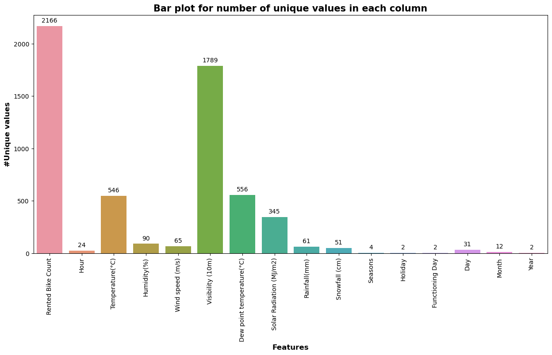
UNIQUE FEATURE OF DATASET

Slide 10
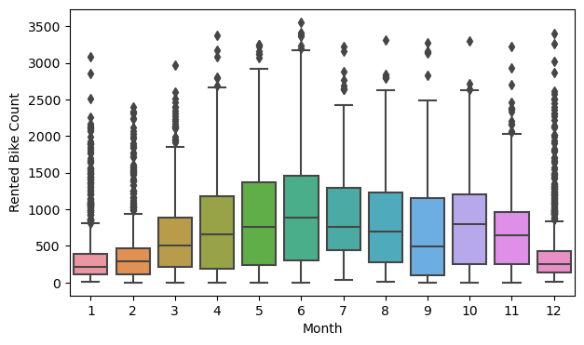
Month wise analysis

Slide 11
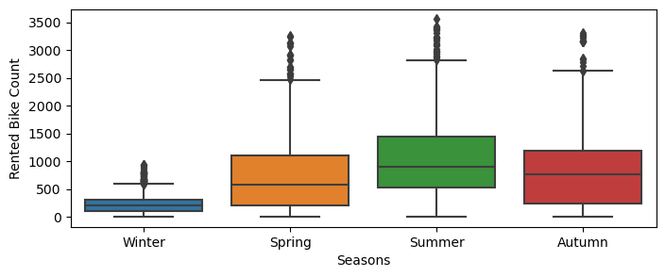
Season by analysis

Slide 12
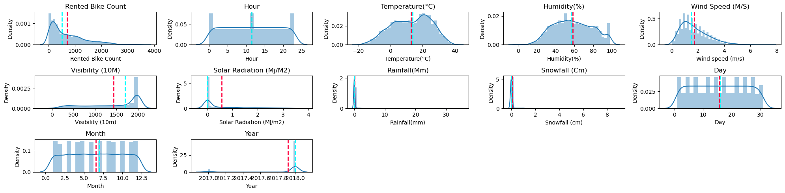
VISUALIZING DISTRIBUTION

Slide 13
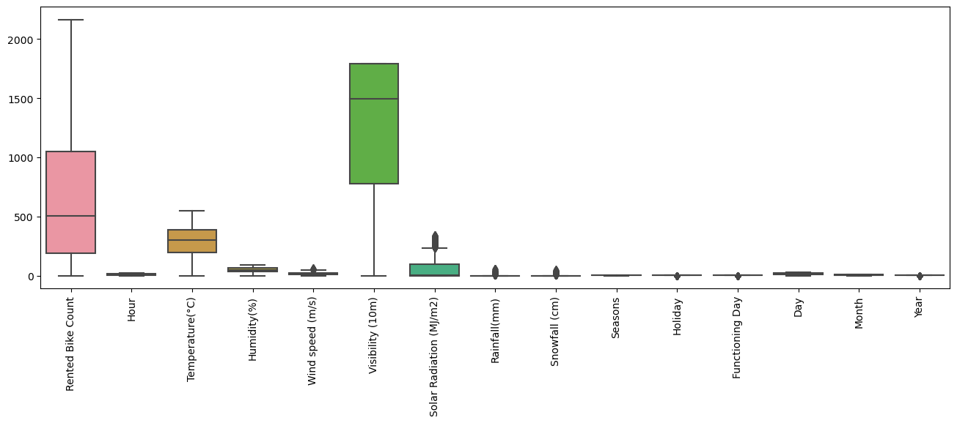
CHECKING OUTLIERS
We see outliers in some columns like Solar radiation, Wind, Rainfall, and Snowfall but lets not treat them because they may not be outliers as snowfall, rainfall etc. themselves are rare event in some countries.

Slide 14
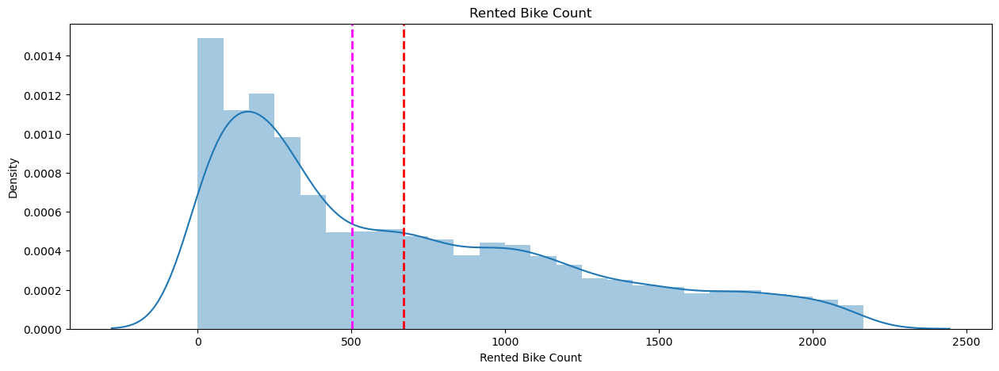
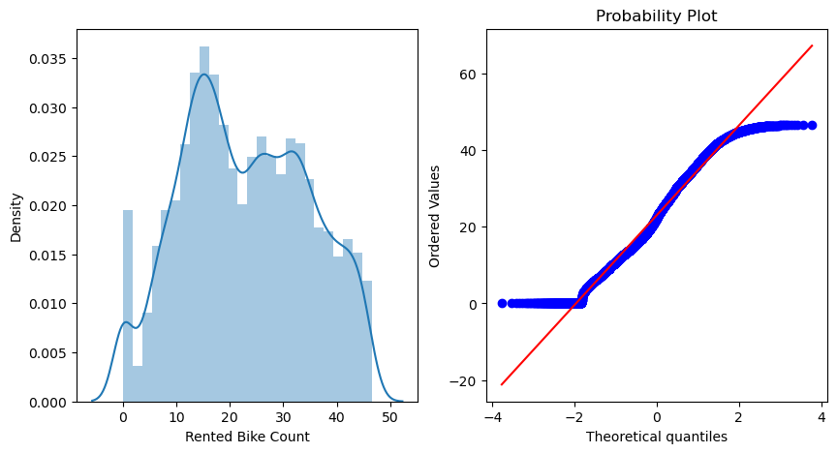
DEPENDENT VARIABLE
Earlier the distribution of the target variable was positively skewed. We tried to make this distribution somewhat close to normal distribution.
First we apply log transform but it did not give desired result, er finally applied square root transformation. We got the favorable results, the skewness value was dropped, which is comparatively closer to the normal distribution.

Slide 15
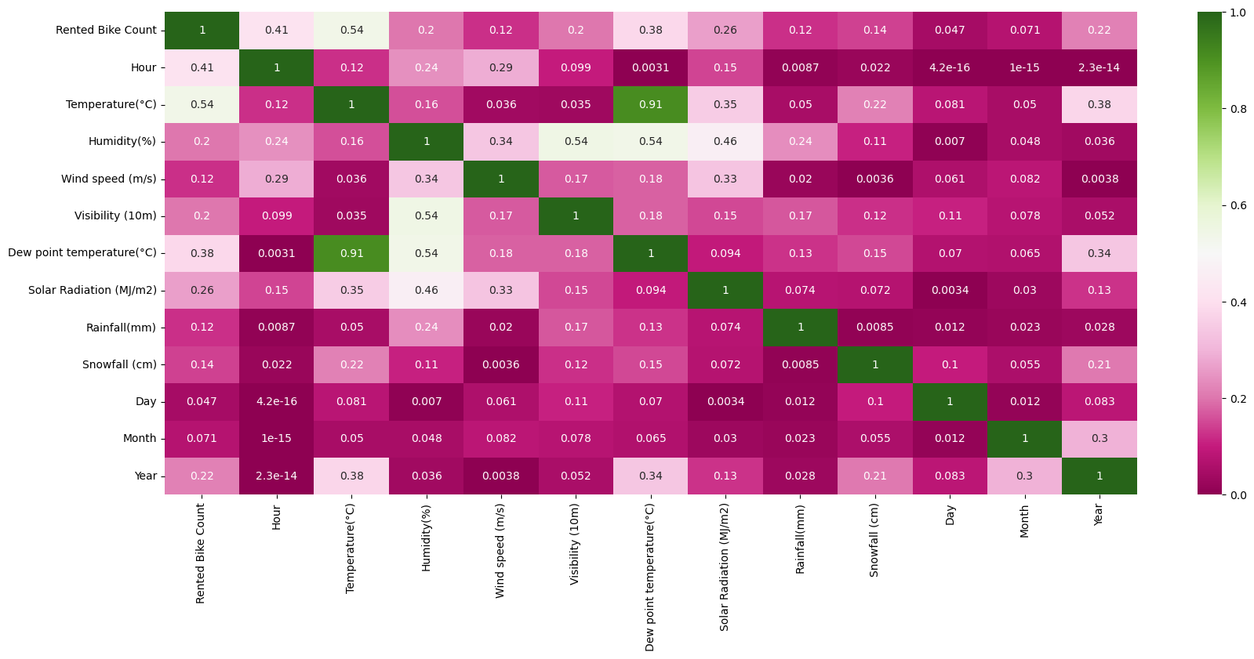
MULTICOLLINEARITY ANALYSIS

Slide 16
MODEL BUILDING PREREQUISITE
Feature Scaling :-
Standardization:
It is a step of data pre processing which is applied to independent variables or features of data. It basically helps to normalize the data within a particular range. Sometimes, it also helps in speeding up the calculations in an algorithm.
Standardization or Z-Score Normalization is the transformation of features by subtracting from mean and dividing by standard deviation. This is often called as Z-score.
X_new = (X - mean)/Std

Slide 17

MODEL BUILDING PREREQUISITE
Normalization:-
Normalization scales our feature to a predefined range (normally the (0-1) or (-1 to 1) range), independently of the statistical distribution they follow. It does this using minimum and maximum values of each feature in the dataset.

Slide 18
MODEL BUILDING PREREQUISITE
Defining a new function called tnt_model which takes model, X_train, y_train, X_test, y_test and print evaluation matrix like MSE, RMSE, R2, Adejusted R2. Also plots the feature importance based on the algorithm used.
We also defined range of values for hyperparameters such as:
Number of trees: n_estimators =[80,100,150]
Maximum depth of trees: [15,20,30]
Min no of sample required for split a node: [40,60]

Slide 19
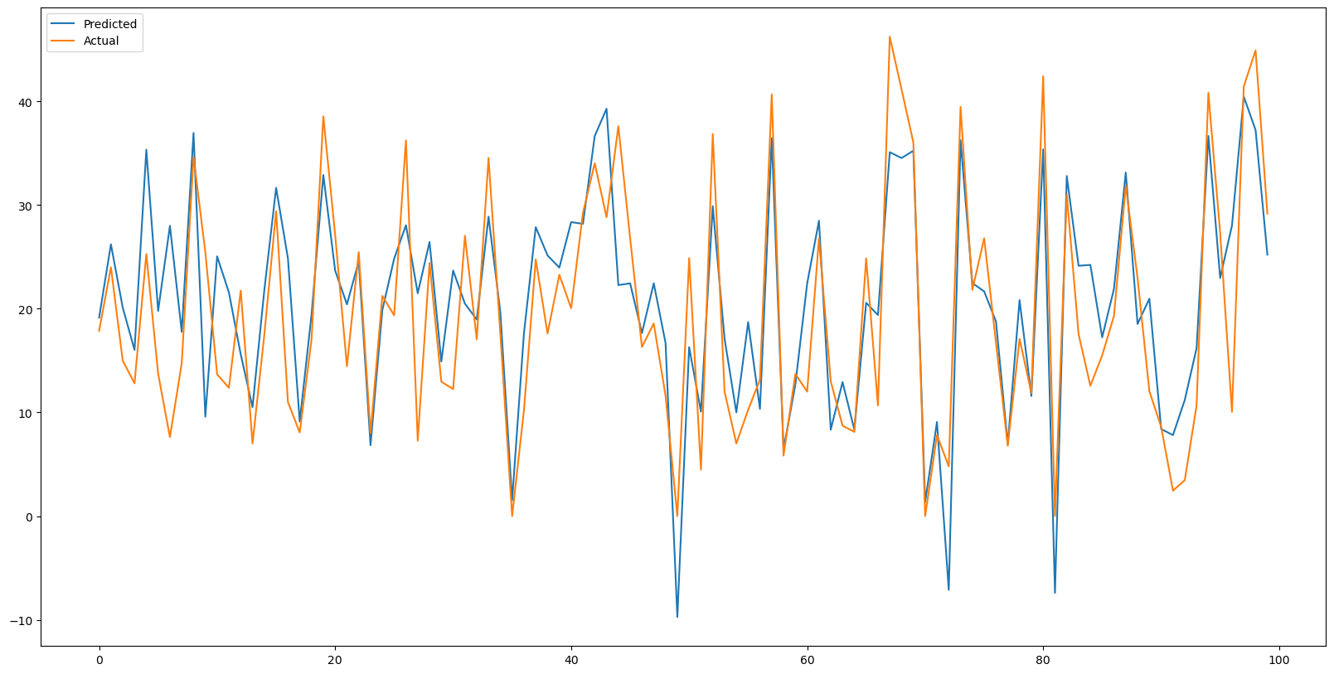
LINEAR REGRESSION
We plotted the graph of actual and predicted dependent variable ‘Rented bike count’.
Since the performance of simple linear model is not so good. We experienced with some complex models.
R^2 is 0.6484023843668462 Adj R^2 is 0.6456800681052435 RMSE is: 6.782028398532068

Slide 20
LASSO REGRESSION
Train_Time': 0.0073049068450927734, 'Train_R2_Score': 0.6362247150339719, 'Test_R2_Score': 0.6434832997542703, 'Test_RMSE_Score': 6.573890897623658},

Slide 21
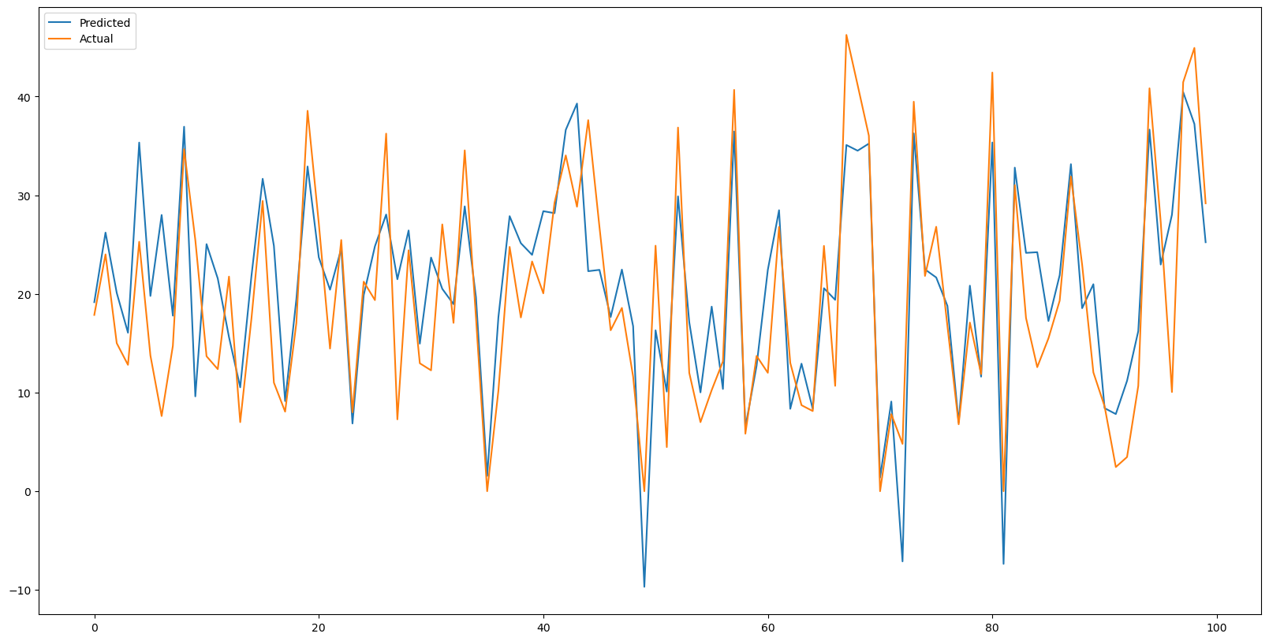
RIDGE REGRESSION
'Train_Time': 0.00572657585144043, 'Train_R2_Score': 0.6478907426327043, 'Test_R2_Score': 0.6583560977217399, 'Test_RMSE_Score': 6.435308776306985},

Slide 22

Kneighbors Regressor
'Train_Time': 0.0337824821472168, 'Train_R2_Score': 0.7595401403043068, 'Test_R2_Score': 0.634924859314125, 'Test_RMSE_Score': 6.65232844723656},

Slide 23
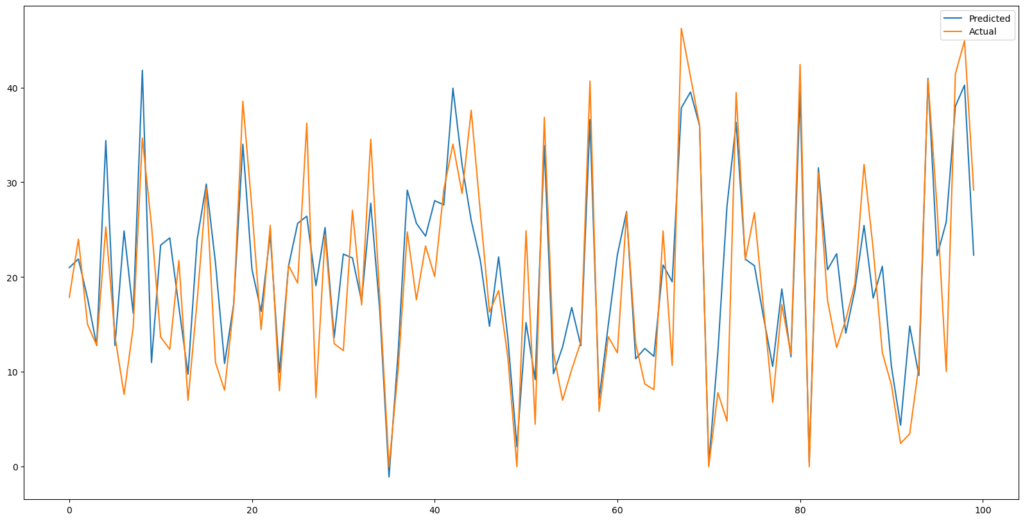
RandomForest
Train_Time': 2.701019763946533, 'Train_R2_Score': 0.9856886070746491, 'Test_R2_Score': 0.888823081636463, 'Test_RMSE_Score': 3.6710463593841647},

Slide 24
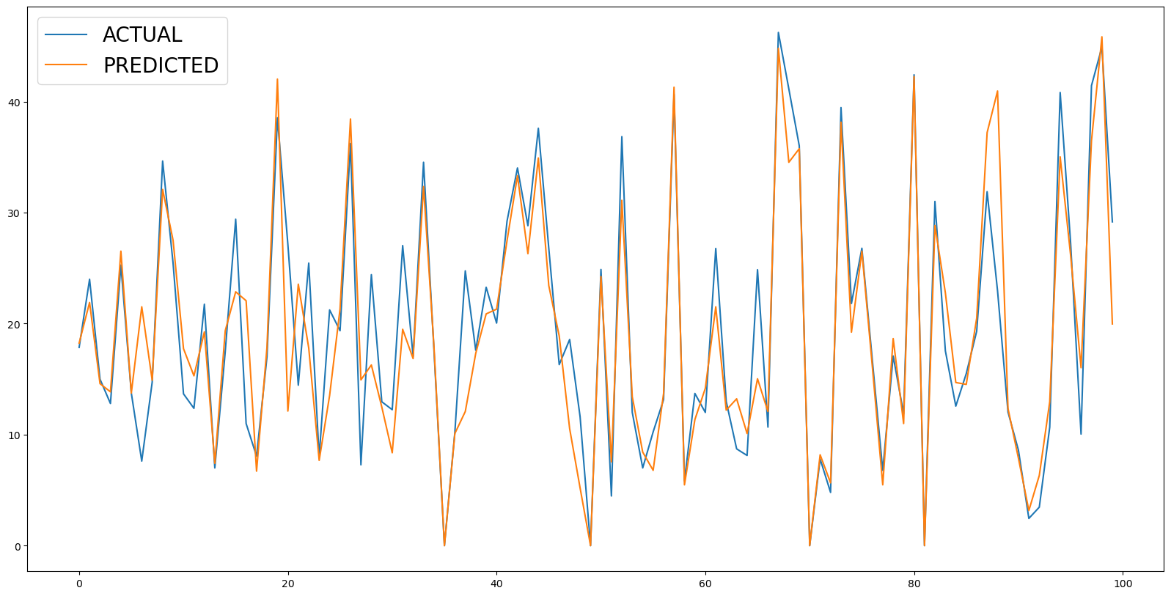
DECISION TREE REGRESSOR
R^2 is 0.7972077617288611 Adj R^2 is 0.7956376014563626 RMSE is: 5.150653181318811
DecisionTreeRegressor performs well better than linear and regularization reg with a test R2 score is more than 75%

Slide 25
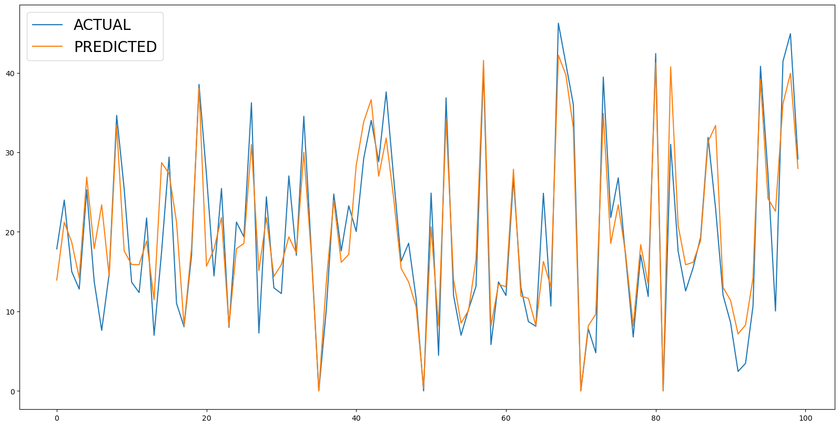
RANDOM FOREST REGRESSOR
R^2 is 0.9005101729901095 Adj R^2 is 0.8997398527095088 RMSE is: 3.607663156942357

Slide 26
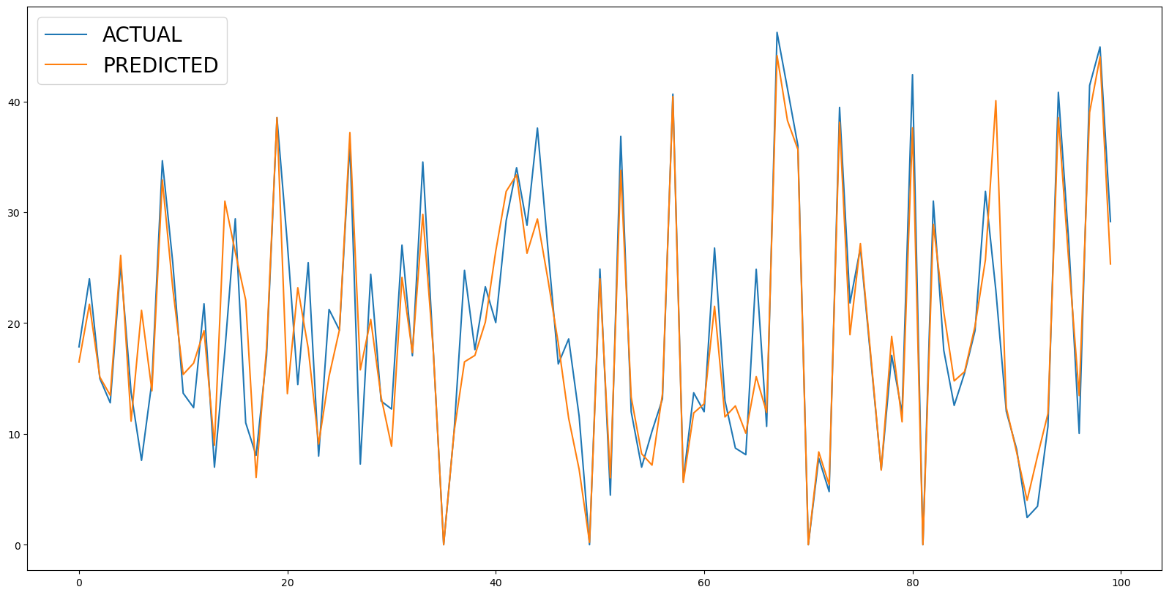
GRADIENT BOOSTING
Train_Time': 0.867929220199585, 'Train_R2_Score': 0.8888860544961422, 'Test_R2_Score': 0.8721452129906446, 'Test_RMSE_Score': 3.9367791284111964},

Slide 27
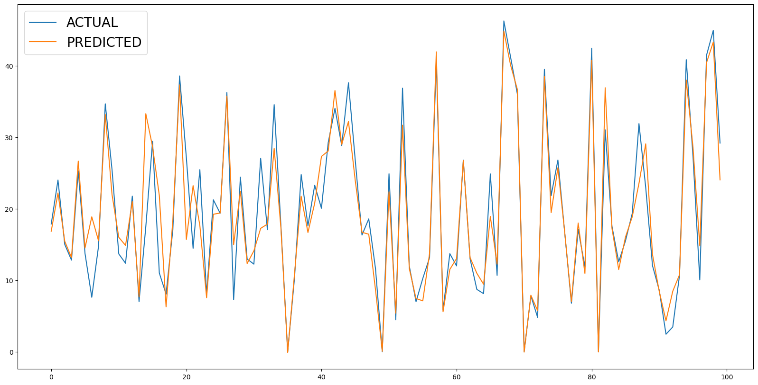
EXTREME GRADIENT BOOSTING
XGBoost regressor emerges as the good model according to the evolution matrix score.
Train_Time': 0.3668050765991211, 'Train_R2_Score': 0.8866652042037074, 'Test_R2_Score': 0.8704475104859376, 'Test_RMSE_Score': 3.9628299303029495},

Slide 28
Light-GBM GRADIENT BOOSTING
The Best technique for Prediction. Its result is more than
90%.
Train_Time': 0.24803638458251953, 'Train_R2_Score': 0.970814771075317, 'Test_R2_Score': 0.907160067519356, 'Test_RMSE_Score': 3.354671205399188},

Slide 29
Matrics of different Models
Index | Name | Train_Time | Train_R2_Score | Test_R2_Score | Test_RMSE_Score
0 | LinearRegression: | 0.007596254348755 | 0.647890787704074 | 0.658363506892344 | 6.435238995229650
1 | Lasso: | 0.047021865844727 | 0.636224715033971 | 0.643483299754270 | 6.573890897623650
2 | Ridge: | 0.021013259887695 | 0.647890742632704 | 0.658356097721739 | 6.435308776306980
3 | KNeighborsRegressor: | 0.062907457351685 | 0.759540140304306 | 0.634924859314125 | 6.652328447236560
4 | SVR: | 3.580235958099360 | 0.457188406684016 | 0.465150454219353 | 8.051899927587920
5 | DecisionTree | 0.078901529312134 | 1.000000000000000 | 0.796217103396044 | 4.970114780880590
6 | RandomForest | 3.896503210067740 | 0.985688607074649 | 0.888823081636463 | 3.671046359384160
7 | ExtraTreeRegressor : | 1.902028560638420 | 1.000000000000000 | 0.895522920619795 | 3.558713819105640
8 | GradientBoostingRegressor: | 0.917283296585083 | 0.888886054496142 | 0.872145212990644 | 3.936779128411190
9 | XGBRegressor: | 0.459384441375732 | 0.886665204203707 | 0.870447510485937 | 3.962829930302940
10 | Light-GBM: | 0.329719543457031 | 0.970814771075317 | 0.907160067519356 | 3.354671205399180
11 | MLPRegressor: | 7.672696828842160 | 0.061209032555181 | 0.062296583029987 | 10.661426133123600

Slide 30
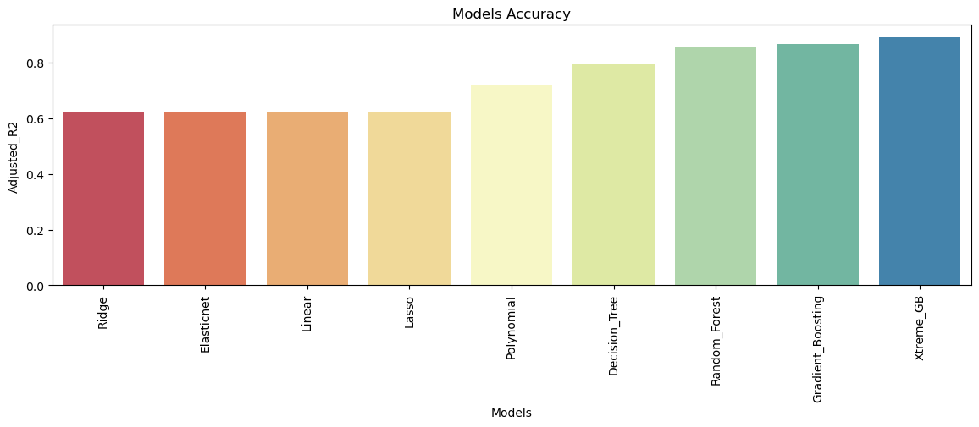
Model Accuracy

Slide 31
Conclusion
The independent variable in the data does not have a good linear relation with the target variable so the simple linear model was not performing good on this data. Tree based algorithm perform well in this case.
There is a surge of high demand in the morning 8AM and in evening 6PM as the people might be going to their work at morning 8AM and returning from their work at the evening 6PM.
After performing the various models the Gradient Boosting and Extreme Gradient Boosting found to be the best model that can be used for the Bike Sharing Demand Prediction since the performance metrics (mse,rmse) shows lower and (r2,adjusted_r2) shows a higher value for the Gradient Boosting and Extreme Gradient Boosting models !
We can use either Gradient Boosting and Extreme Gradient Boosting model for the bike rental stations. But best bodel is Light-GBM GRADIENT BOOSTING.

Slide 32
summary
we believe in giving 110%. By using our next-generation data architecture, we help organizations virtually manage agile workflows. We thrive because of our market knowledge and great team behind our product."​

Slide 33
Thank you
Raghvendra Singh
Raghvendra.rbmi197@gmail.com

